Slide 1
Monty Hall - Monte Carlo Simulation
Carlos Mercado, Maria Guimaraes, Edgar Renteria, Jordan Nicholls

Slide 2
Motivations
Understand the correct approach to the problem.
To demonstrate the role of probability in decision-making.
To explore variations of the problem.

Slide 3
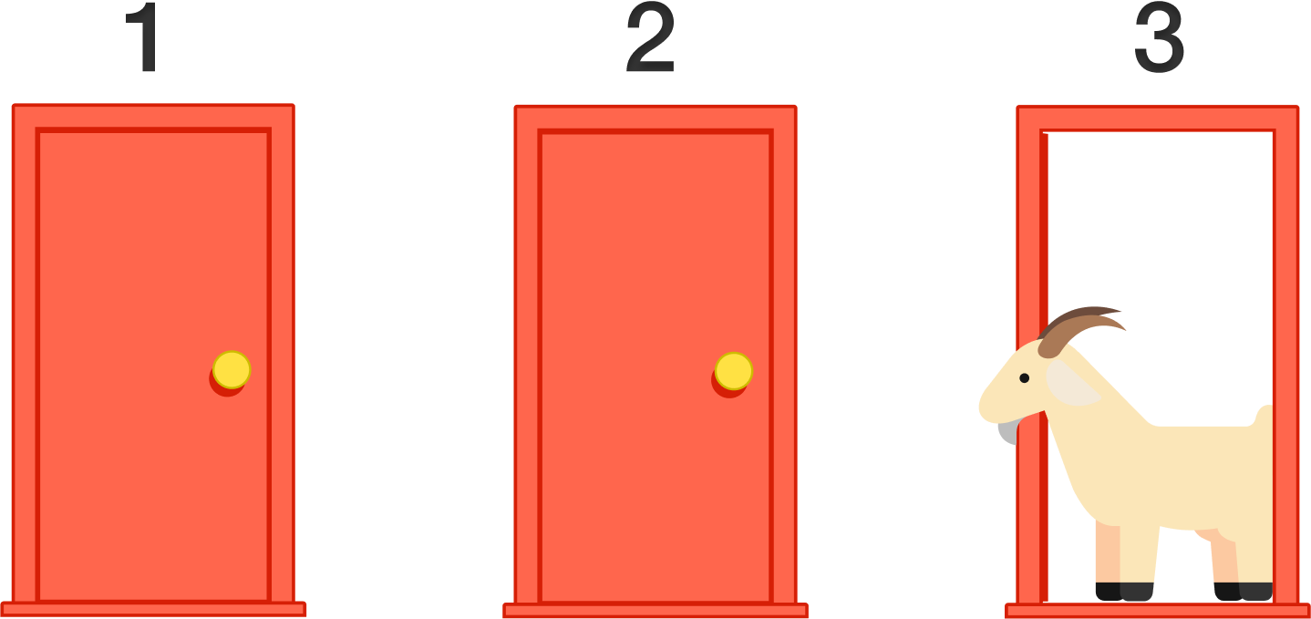
Problem Statement
In the game, a contestant chooses one of three doors, behind one of which is a car, while behind the other two are goats. After the contestant has made their initial selection, the host, who knows what is behind each door, opens one of the other two doors to reveal a goat. The contestant is then given the option to switch their choice to the remaining door(s) or stick with their original choice.
This is game is extended to 6, 9, 20 and 100 doors.

Slide 4
Approach
Build the stage
create a list with goats stored in every cell except for one.
Contestant choice
generate a random number between 0 and the size of the list.
Take away a door.
Find a cell in the list that is not the one that the contestant chose, and one that does not contain the car, and delete it.
Second choice.
If the approach is to stay with the original door, then check the chosen cell to see if the car was chosen, if so, the contestant wins.
If the approach is to switch doors, then delete the current cell and go to a random cell in the list.
Do this multiple thousands of times to get good, representative rate of wins.

Slide 5
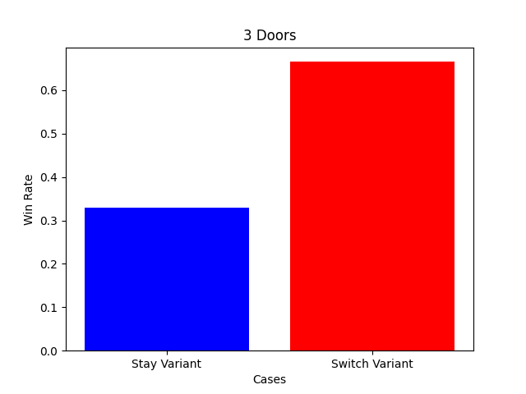
Results & Discussion
Switch is the obvious choice in the n=3 doors case. Twice as likely to get the car if we switch doors ⅓ -> ⅔ .

Slide 6
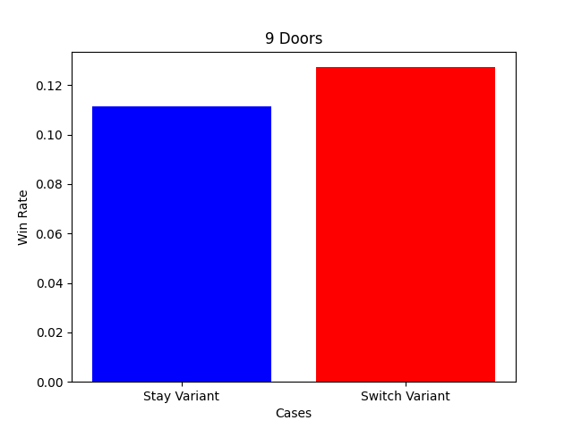
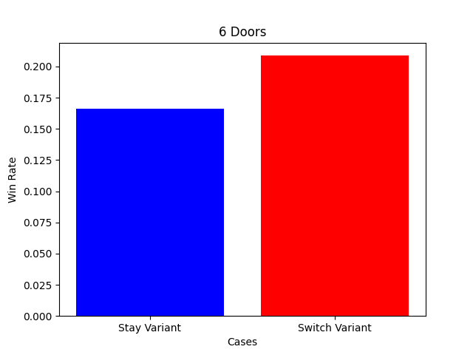
Results & Discussion
Switch is still best choice in the n=6 doors case as well as the n = 9 doors case but the difference is not as dramatic.

Slide 7
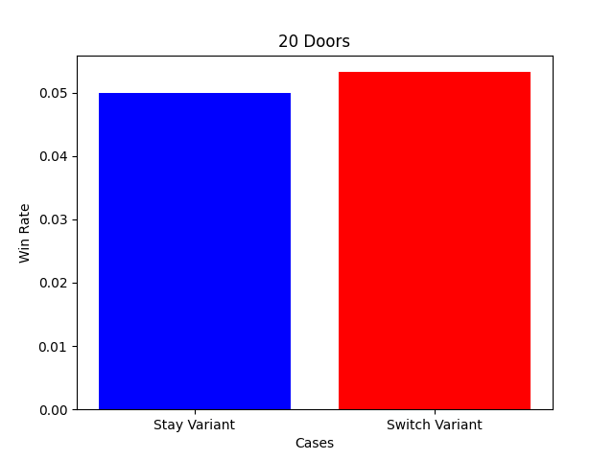
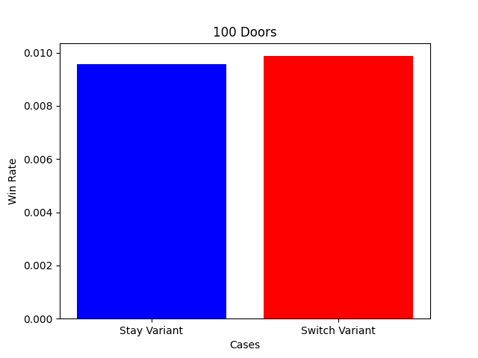
Results & Discussion
Switching in the last two cases is still better than staying but the difference becomes marginal.

Slide 8
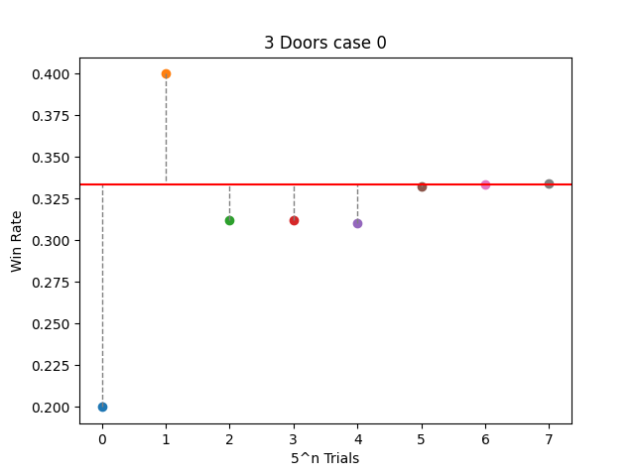
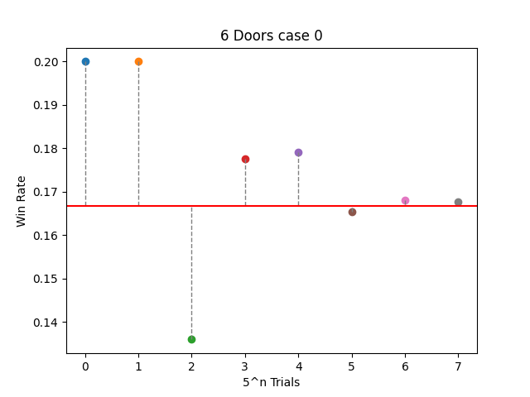
Results & Discussion (The Importance Of Iterations)

Slide 9
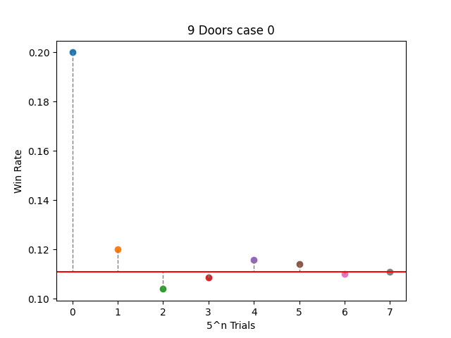
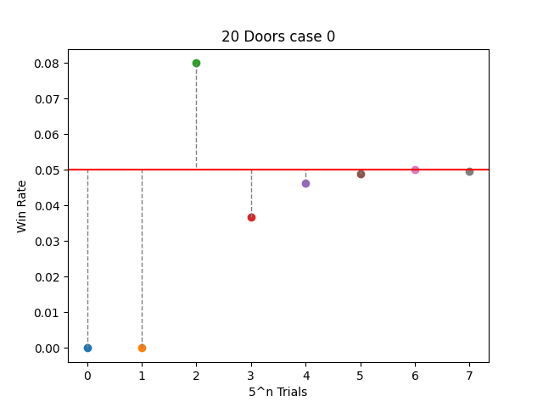
Results & Discussion (The Importance Of Iterations)

Slide 10
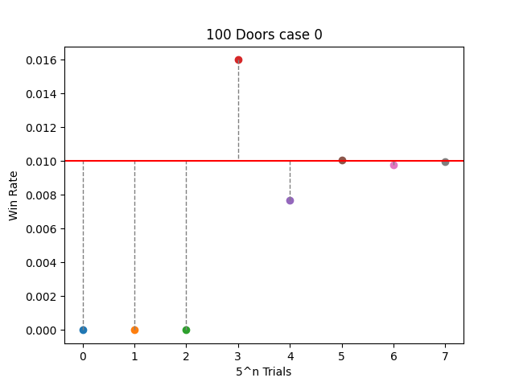
Results & Discussion (The Importance Of Iterations)

Slide 11
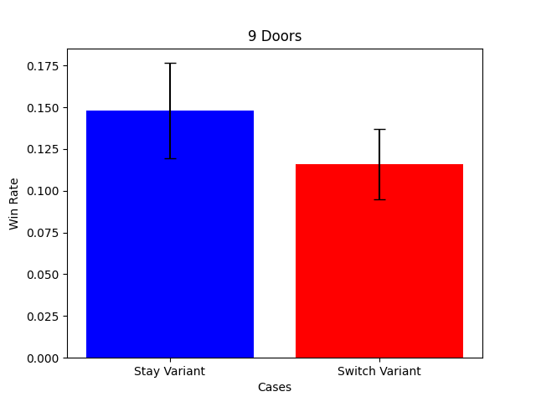
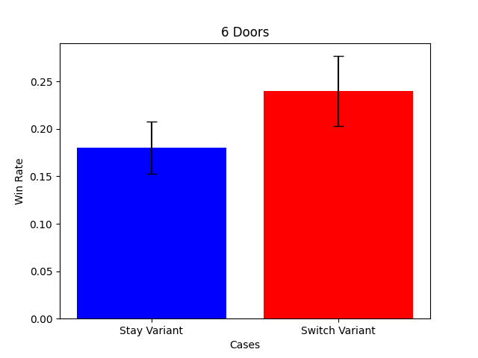
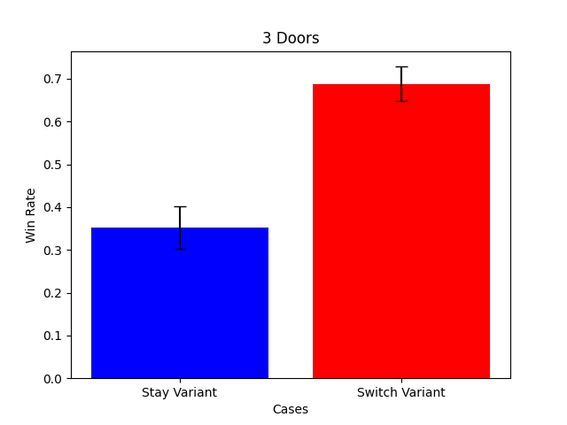
Importance of Iterations (cont.)

Slide 12
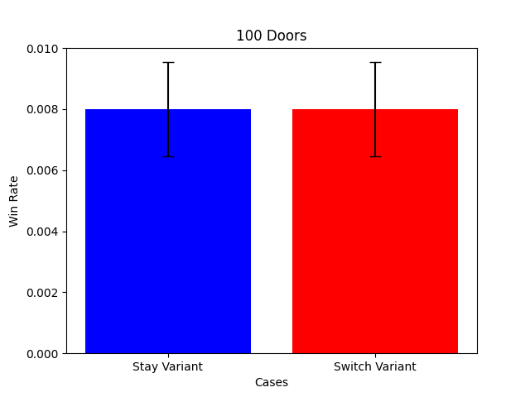
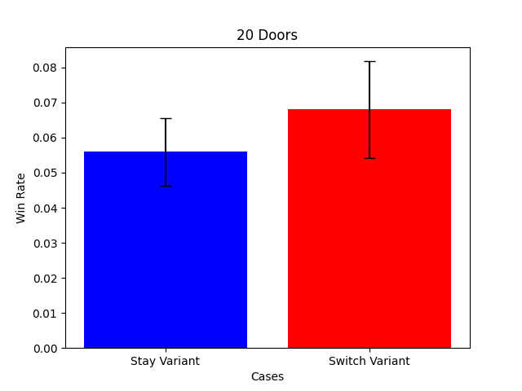
Importance of Iterations (cont.)

Slide 13
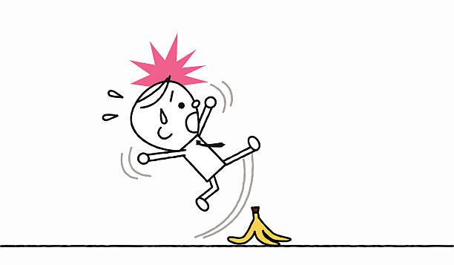
Problem Statement 2 (Monty Fall)
In this variant of the game, once the contestant has selected one of the doors, the host slips on a banana peel and accidentally pushes open another door (that could be the car).
This is variant is also extended to 6, 9, 20 and 100 doors.

Slide 14
Approach
Almost identical to the original approach, but with one note.
The host can open the car door, but that does not count as a win or a loss for the contestant. We don’t even count it as a trial

Slide 15
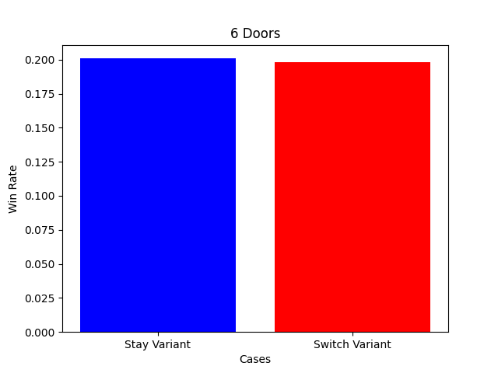
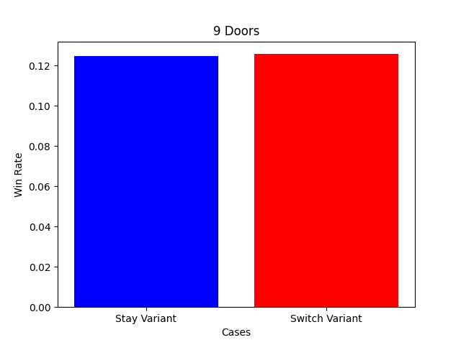

Results & Discussion
For all door counts, the odds of winning in each of the approaches is the same.

Slide 16
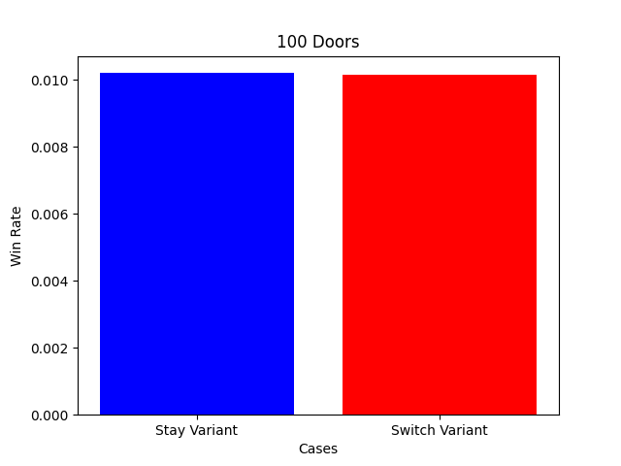
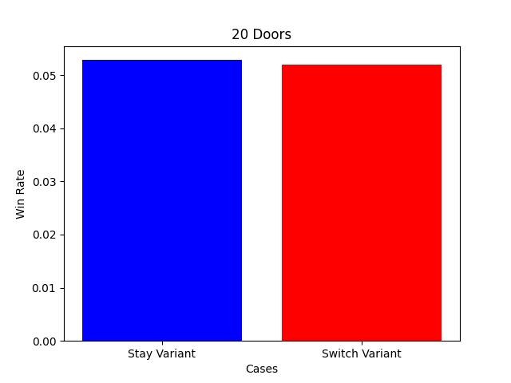

Slide 17
Conclusions
Switching is always the best choice
As there is more and more doors, the advantage gained from switching becomes smaller and smaller.
The more iterations the better.

